Slide 1

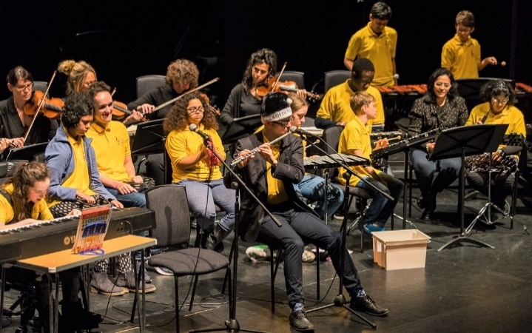
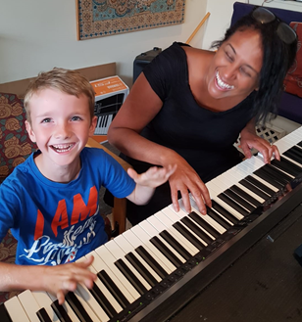
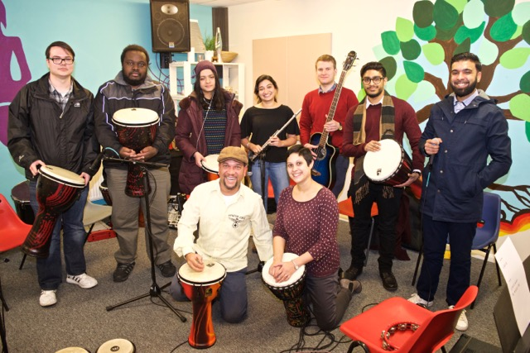

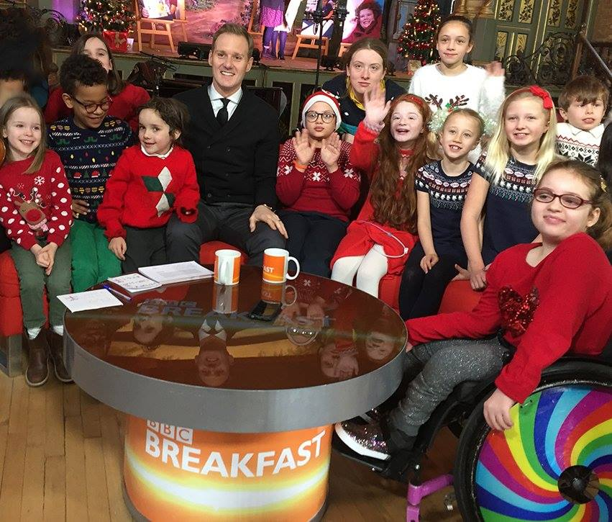



OK MUSIC SCHOOL:
Teaches children and young people with additional needs aged 5-25 to play instruments or sing, increasing their confidence and social skills. Pupils perform in public concerts and some have passed music exams.
“I love music because it gives me confidence and takes me away from the pressures of real life”
OK YOUTH CHOIRS:
Inclusive Choirs in 2 age groups for children and young people of all abilities, to help them make friends and gain confidence. The choirs perform at our 2 annual concerts and enjoyed appearing on BBC Breakfast
PLEASE SUPPORT US
Our mission is to ensure that everyone has access to affordable music therapy, helping to improve their wellbeing and quality of life through creative and participatory music making.
For more information on all our services and how we can help, please visit our website or call or email us at the contact details below.
If you want to support our work, go to www.justgiving.com/okmtrust
Otakar Kraus Music Trust
3 Twining Avenue Twickenham
Middlesex TW2 5LL
Tel: 07435 062212
Email: info@okmtrust.org.uk
Website: www.okmtrust.org.uk
Engage with us on social media:
www.facebook.com/otakarkrausmusictrust Twitter: @OKmusictrust www.youtube.com/OKmusictrust
Registered Charity No 1178401
MUSIC THERAPY
A key to a better quality of life through the power of music
“It has helped us realise the impact music can have in our daily lives”

Slide 2
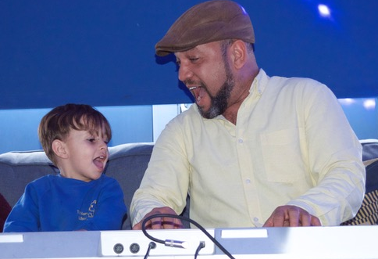
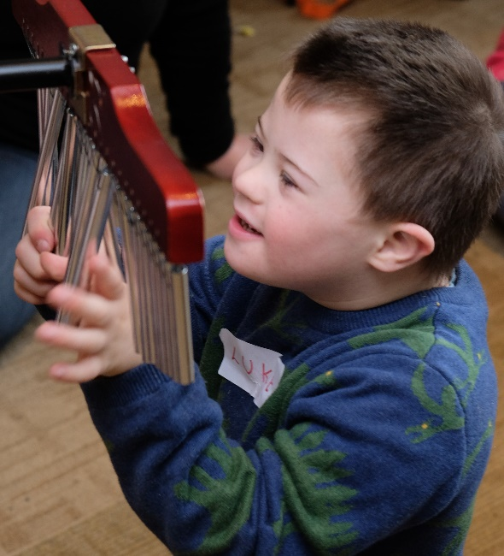
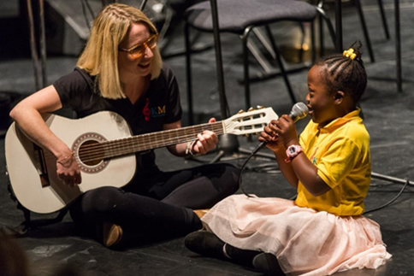
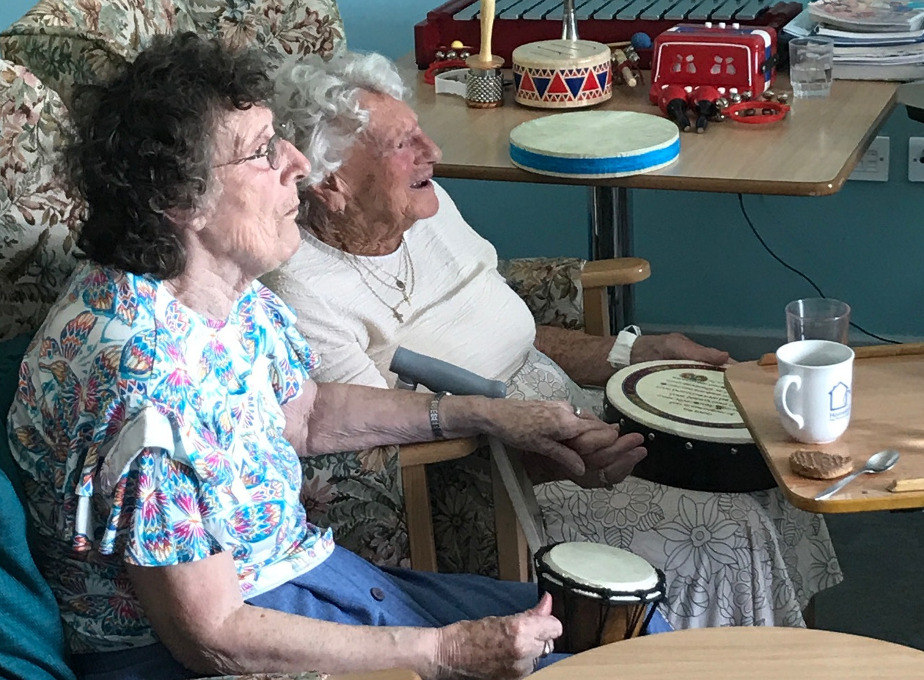

The Otakar Kraus Music Trust (OKMT) was founded by Dr Margaret Lobo in 1991 and provides music therapy for people who have physical, learning, psychological or neurological difficulties in order to improve their well-being and quality of life.
MUSIC THERAPY
Music therapy is a scientifically proven method of reaching people based on the understanding that the ability to respond to music remains unimpaired by disability, illness or trauma.
It is particularly effective for those who find it hard to communicate through traditional methods, as it can enable them to express themselves and interact with others.
OKMT is based in South West London and annually provides over 3000 individual and group music sessions to 300 people of all ages, from toddlers to the elderly
Music therapy can help people with:
Learning Difficulties
Developmental Delay
Autistic Spectrum Condition
Down’s Syndrome
Mental Health Problems and Stress
Stroke and other Neurological Conditions
Dementia
“The Sessions lift their mood and bring a sense of belonging”
Music Therapy helps to improve:
Speech & Communication Skills
Confidence and Self-esteem
Social Interaction Skills
Emotional Well-being
Focus and Concentration
Motor Skills
Self-expression
Creativity and Choice
“It has been a really profound experience to express my feelings through music”
OUR PROJECTS
OK MUSIC CLUB:
Group sessions for children with disabilities and their siblings aged 4 months to 7 years, to encourage creativity, concentration and communication skills.
OK MUSIC GROUP:
Music sessions for young people and adults with mental health problems to help them interact with others and improve their emotional well-being.
“I have found singing very uplifting”
OK MUSIC HARMONY:
Music groups for elderly people at Homelink Day Care Respite Centre, to help them share old memories and have a positive social experience.
Communication Difficulties
“The Music Group has really changed my life”

